Slide 1
Programming for Non-Programmers
The Basics
Presented by: Mike Lipsitz

Slide 2
Who Am I?
Hail To The Victors!
Professionally developing code for over 10 years
Vice President of Engineering for a Startup with Non-Technical Founders
Consultant while building my own Startup
https://www.bachpartymatch.com

Slide 3
Goals
Be able to “talk the talk” (or at least understand it)
Have an overview of the components of a website and how they fit together
Understand HTML vs CSS vs JS vs Other Languages
Resources for where to go when stuck or to continue learning
Notes:
Will break down each major component of websites so that you’ll be able to understand the context of what’s being discussed
Will get into the process of writing code which will help you take an idea and turn it into a working thing

Slide 4
Who are you?
Name?
Current Profession or Activity?
Ever written any code? What’d it do?
What do you want out of this class?

Slide 5
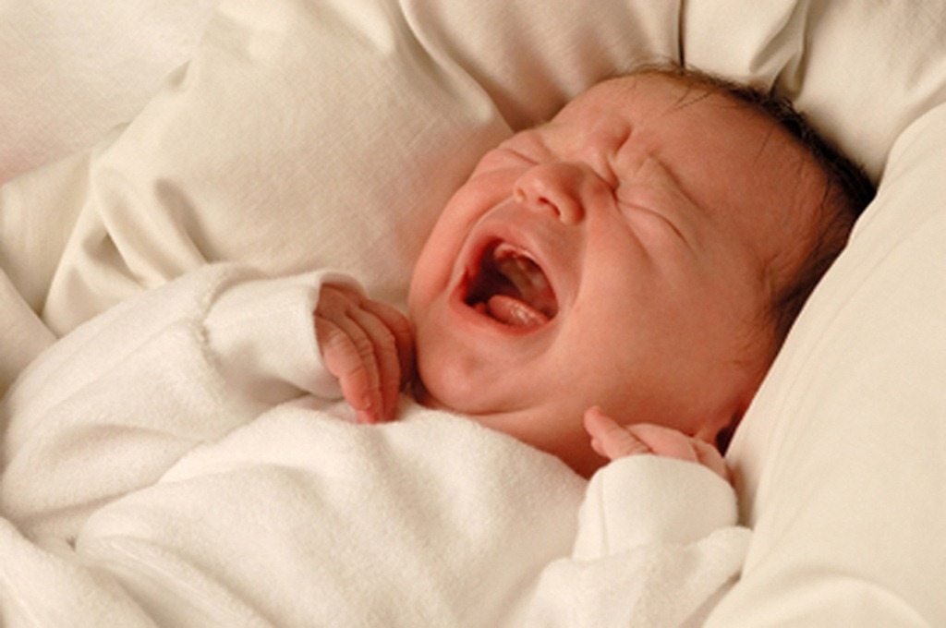

Agenda
Notes:
Ask questions at any point

Slide 6
Agenda
Programming 101
Servers Vs Browsers
Process of Writing Code
HTML
CSS
Build a Website!
Programming 102
Databases
JS
Node.js / APIs
Build a Web App!
Notes:
Programming 101
What is programming?
Why are there so many programming languages and how do they fit together?
Back-end vs Front-end Development
Back-end and Front-End Frameworks
Servers Vs Browsers
What are Requests and Responses?
The anatomy of a web server
Process of Writing Code
Web Development Process
Programming 102
Basic Programming Concepts
APIs
Creating your own

Slide 7
Programming 101

Slide 8
Programming 101
What are programs or applications made of?
How do they accomplish a given task?

Slide 9
Programming 101
What are programs or applications made of?
How do they accomplish a given task?
Instructions -> instructions -> instructions -> instructions

Slide 10
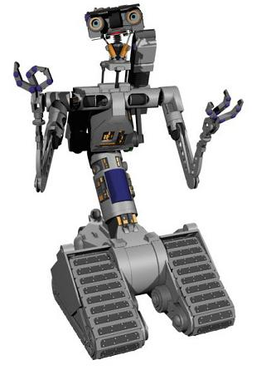

Programming 101
How do I clean my room?
???
Clean My Room!

Slide 11

Programming 101
Pick up toys
Put toys in toy chest
Pick up clothes
Put clothes in hamper
Make bed

Slide 12
Programming 101
Languages are sets of Instructions
Pick up toys
Put toys in toy chest
Pick up clothes
Put clothes in hamper
Make bed
Put pillows on bed
Put stuffed animals on pillows
Pick up books
Put books on shelves
Open toy chest
Close toy chest
Open hamper
Closer hamper
Pick up toys
Put toys in toy chest
Pick up clothes
Put clothes in hamper
Make bed

Slide 13
Programming 101
Programs are ordered sets of Instructions to accomplish a task
Open toy chest
Pick up toys
Put toys in toy chest
Open hamper
Pick up clothes
Put clothes in hamper
And so on…
Pick up toys
Put toys in toy chest
Pick up clothes
Put clothes in hamper
Make bed

Slide 14
Programming 101
Let’s run a Program!

Slide 15
Programming 101
Exercise
In pairs, let’s draw a picture!
1 Programmer and 1 Computer
Programmer is giving instructions
Computer is executing instructions
1 pen per pair
Programming Language
Pick up pen
Put pen down
Stop pen
Move pen Up
Move pen Down
Move pen Left
Move pen Right

Slide 16
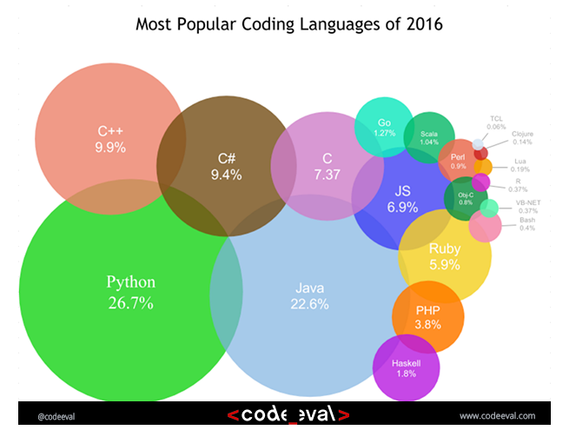
Programming 101

Slide 17
Programming 101
Why so many languages?
New features
Ease of use
Specific applications
Specific focus
Notes:
New features
Things that you used to have to do by hand are now abstracted away
Security
Drawing
Ease of use
Less instructions to accomplish same thing
More clear coding styles
Specific applications
The exercise drawing language
Power plants
Finance
Specific focus
Security
Speed
Big data

Slide 18
Programming 101
Frameworks and Libraries
Hide details of implementations, just give you functionality
Can be updated and benefits magically flow through
Allow others to use your solution to a problem
Languages can have many Frameworks which can have many Libraries
Libraries can be used without using a Framework
Notes:
Split is kind of ambiguous

Slide 19
Programming 101
Frameworks
Typically an open source collection of open source libraries
Provide baseline of functionality for a given goal
Libraries
All of the code to accomplish the described task
Usually a more focused and smaller task than a Framework will be trying to accomplish
Notes:
Languages have frameworks which have libraries

Slide 20
Programming 101
Frameworks (Language)
Ruby On Rails (Ruby)
Laravel (PHP)
Twitter Bootstrap (CSS)
Angular (JS)
Libraries (Language)
jQuery (JS)
D3.js (JS)
SASS (CSS)
LINQ (C#)

Slide 21
Programming 101
Types of Applications
Static Web Sites
Dynamic Web Sites
Native Applications (Phones – multiple platform choices)
Native Applications (Desktops – multiple platform choices)
Everything else
Notes:
Overview the types, don’t get into details though - Breakdown on the next slides!

Slide 22
Programming 101
Web Site vs Web App
Static
No action will change the site
Every person who goes there will see the same thing
Dynamic
Changes depending on the user
User actions have responses and results
Likely requires a database to store the state
Notes:
State is the representation of all the stored information, at a given instant in time, to which the program has access

Slide 23
Programming 101
Web App vs Native Mobile App
Browser doesn’t get access to everything the phone can do
Browser is slower
Native app will only work on that phone’s platform

Slide 24
Programming 101
Front-End vs Back-End
Split between programming code that lives on:
A User’s machine (browser)
JavaScript (and front end frameworks like Angular)
HTML / CSS
A Server
C#
Ruby
PHP
Python

Slide 25

Programming 101
?

Slide 26
Servers Vs Browsers

Slide 27
Servers Vs Browsers
Static Files
Server Code
Database
JavaScript
HTML
CSS
Web Server
User’s Machine

Slide 28
Servers Vs Browsers

Slide 29
Servers Vs Browsers
Static Files
Server Code
Database
JavaScript
HTML
CSS
Web Server
User’s Machine

Slide 30
Servers Vs Browsers
Type www.google.com -> Press Enter -> GET Request
Notes:
It all begins with the request
Point is that when you hit enter in the url bar, you’re triggering what is going to be the first of many requests just to load a single webpage

Slide 31
Servers Vs Browsers
Request Types
Get / Post / Put / Delete
Synchronous Vs Asynchronous
Response Codes
RESTful APIs
http://api.example.com/resources/
http://api.example.com/resources/item17
Notes:
REST = Representational state transfer
Collection, such as http://api.example.com/resources/
GET: List the URIs and perhaps other details of the collection's members.
PUT: Replace the entire collection with another collection.
POST: Create a new entry in the collection. The new entry's URI is assigned automatically and is usually returned by the operation.[16]
DELETE: Delete the entire collection.
Element, such as http://api.example.com/resources/item17
GET: Retrieve a representation of the addressed member of the collection, expressed in an appropriate Internet media type.
PUT: Replace the addressed member of the collection, or if it does not exist, create it.
POST: Not generally used. Treat the addressed member as a collection in its own right and create a new entry in it.[16]
DELETE: Delete the addressed member of the collection.

Slide 32
Match the Requests!
Using the handout, connect the action with the correct type of request!

Slide 33
Servers Vs Browsers
Static Files
Server Code
Database
JavaScript
HTML
CSS
Web Server
User’s Machine

Slide 34
Servers Vs Browsers
Static Files
Server Code
Database
JavaScript
HTML
CSS
Web Server
User’s Machine
Notes:
Pieces that run on the user’s machine

Slide 35
Servers Vs Browsers
Static Files
Server Code
Database
JavaScript
HTML
CSS
Web Server
User’s Machine
Notes:
Collection of elements and content that are going to be displayed on your website

Slide 36
Servers Vs Browsers
Static Files
Server Code
Database
JavaScript
HTML
CSS
Web Server
User’s Machine
Notes:
Client Side Logic
User pushes a button, says now do this
Triggers requests that don’t require a full page refresh
AJAX (Asynchronous JavaScript and XML)

Slide 37
Servers Vs Browsers
Static Files
Server Code
Database
JavaScript
HTML
CSS
Web Server
User’s Machine
Notes:
Describes the look
Any animations

Slide 38
Servers Vs Browsers
?

Slide 39
Servers Vs Browsers
Static Files
Server Code
Database
JavaScript
HTML
CSS
Web Server
User’s Machine
Notes:
Server Side

Slide 40
Servers Vs Browsers
Static Files
Server Code
Database
JavaScript
HTML
CSS
Web Server
User’s Machine
Notes:
Things like image files, javascript files, things that won’t change no matter who is accessing the site or what they’re trying to do

Slide 41
Servers Vs Browsers
Static Files
Server Code
Database
JavaScript
HTML
CSS
Web Server
User’s Machine
Notes:
Source of all user entered or automatically collected data
Relational vs non
Table vs Web
Implementations
MySQL (Relational)
PostgreSQL (Object-Relational)
Mongo (NoSQL)

Slide 42
Servers Vs Browsers
Static Files
Server Code
Database
JavaScript
HTML
CSS
Web Server
User’s Machine
Notes:
Server side logic
Validation and translation of client data
Action or inaction based on rules built to accomplish what the program is trying to do
Create, Update, Read, or Delete things on the DB
Languages
Node.js (Javascript)
C#
PHP
Ruby
Java
Python

Slide 43
Servers Vs Browsers
Static Files
Server Code
Database
JavaScript
HTML
CSS
Web Server
User’s Machine
Notes:
Review Front end vs back end roles and focuses

Slide 44
Servers Vs Browsers

Slide 45
Servers Vs Browsers
?
Notes:
Exercise coming next

Slide 46
Servers Vs Browsers
Using the handout, connect the activity with the correct area of the code base!

Slide 47
Process of Writing Code

Slide 48
Process of Writing Code
Waterfall vs Agile
Spec To Wireframe To Implementation
Testing
Deploying
Making Choices
APIs
Secrets of Developers

Slide 49
Process of Writing Code
Waterfall
Very process oriented
One big, long journey of:
design -> build -> test -> release -> feedback
Agile
Customized to work however your team works best
Many tiny loops of:
design -> build -> test -> release -> feedback

Slide 50
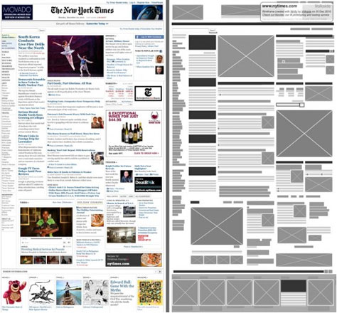
Process of Writing Code
Notes:
Start out being given a wireframe or design of what you need to create
Will have a spec documenting the required features and functionality of the thing to create

Slide 51
Process of Writing Code
Version Control
Stores state of the code
If things go wrong…
Allows for team-wide review and annotation of code
Branches allow for multiple developers to work on same code at once
Common types: git, mercurial
Common Providers: GitHub, BitBucket, VisualStudioOnline
Worst Case: Dropbox
Notes:
Git is more of a set of individual commands that can be combined with more flexibility
Git’s branching, merging, tagging, and rebasing are more smooth
Git can edit previous history
Mercurial is 1 tool that when used in the right scenarios can be much simpler to use

Slide 52
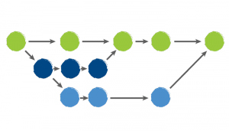
Process of Writing Code
Version Control
Branching
Thread of development
Copy of the code at a point in time
Multiple developers can work on same code at once
Merging
Brings branch of code back into the main flow’s state
Pull Request is opportunity to review
Forking
Copy of the code at a point in time
Usually when making major changes to someone else’s code
Notes:
Pull because you’re asking the owner of the main branch to “pull my changes into the main branch” if they think they’re correct
Hence why this is the point in time of reviewing
Fork -> io.js from nodejs.org and back into it

Slide 53
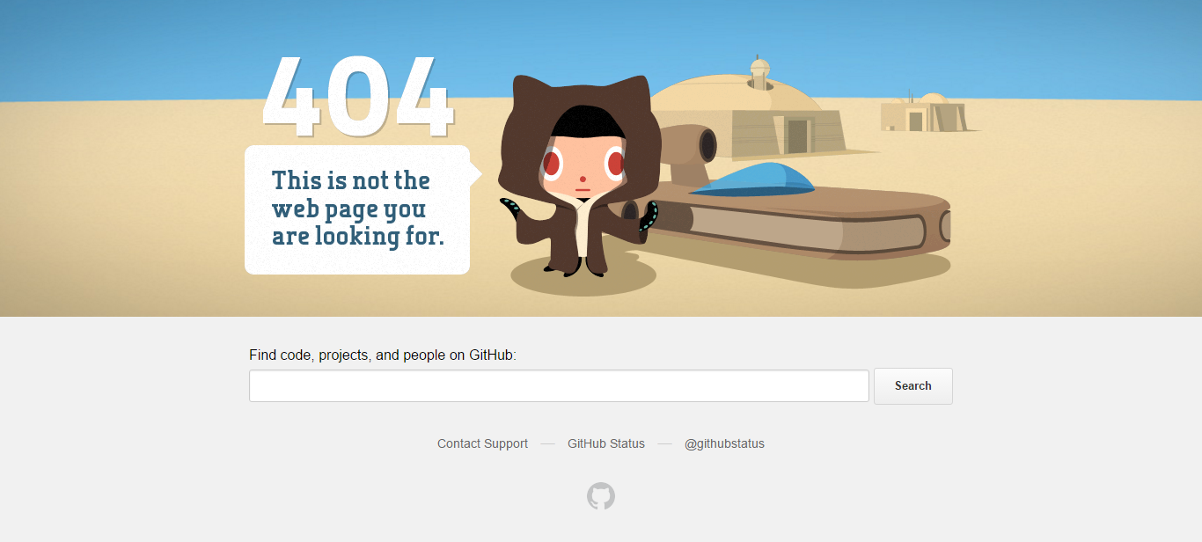
Process of Writing Code
Testing
Notes:
When things do go wrong, what happens?

Slide 54
Process of Writing Code
Testing
Make sure it works!
Manually
Automating with Code
End to End
Functional
Unit
Headless
Notes:
End to end tests are meant to check that a given application task completes from beginning to the end of the process without skipping any steps
Functional tests are meant to check individual pieces of code or functions
Unit tests are meant to check that a given piece of functionality works as expected
Headless tests are tests run in a browser without actually needing the browser, so buttons can be checked if they’re there and clicked and the results checked

Slide 55
Process of Writing Code
Deploying
Use a Cloud Provider
AWS / Azure / Google App Engine / Digital Ocean / etc.
Host it yourself
Continuous Integration
Commit new code -> Run unit tests -> Allow code to be merged
Continuous Deployment
Commit new code -> New deploy to server
Commit new code -> Run unit tests -> (tests passed) New deploy

Slide 56
Process of Writing Code
Making Choices
Which Language?
Community engagement
Difficulty level
Development time
Front end or back end
Experience level
Which Host?
Cost
Speed
Geographic Needs
Support

Slide 57
Process of Writing Code
Making Choices
Which Browsers to Support?
Not all are “Standards” compliant
Older browsers don’t support newer features
Which Outside Services?
Error reporting
Usage gathering
APIs

Slide 58
Process of Writing Code
APIs
Contract between Supplier of data and Consumer
REST vs Non
Public vs Private
Popular APIs: Facebook, Twitter

Slide 59
Process of Writing Code
Secrets of Developers
It’s way more Blood, Sweat, and Tears than it is Magic
Most only know a few languages
Only 1 or 2 extremely well
Learn basic programming concepts and patterns
They translate from language to language
When picking up a new language, allow for more focus on learning syntax and idiosyncrasies rather than everything
I use none of the programming languages I learned in college
I use the concepts, patterns, and problem solving techniques constantly

Slide 60
Process of Writing Code
Secrets of Developers
Best friend is Google
“Never memorize something that you can look up.” - Albert Einstein
Too many components and idiosyncrasies of each language
Good Programmers Copy, Great Programmers Steal
NEVER take code from the internet that you don’t understand
If no exact solution, find something similar, and adapt
Hardest part about programming is starting with a blank page
Notes:
Copy is copy and paste. Steal is taking the concept or how idea works / applied and being able to apply it to your situation.
Not making an exact copy of the slider that I found online, figuring out how theirs works and then using that as inspiration to build it how I need it built.

Slide 61
Process of Writing Code
?

Slide 62
Setting Up Your Development Environment
IDEs
Visual Studio
Eclipse
EMACS
Atom
Use Notepad or Download and Install Atom: https://atom.io/
Download and Install Chrome: https://www.google.com/chrome/browser/

Slide 63
Setting Up Your Development Environment
http://bit.do/mikePFNP
Must have correct case!
Be sure you’re looking at the SingleDay Branch!

Slide 64
HTML

Slide 65
HTML
All of the Content for a site
Contains grouping of content and some stylistic hints and defaults
But ideally no direct styling
<tagname attributeName=“attribute value”>contents</tagname>
<h1 id=“hello-title”>Hello!</h1>
<img src=“https://url-to-img.png” />

Slide 66
HTML
As Basic of a Page’s Structure As Possible
<html>
<head>
All of the page’s metadata
</head>
<body>
All of the page’s contents
<body>
</html>

Slide 67
HTML
Hello World!
<html>
<head>
<title>This is my very first website!</title>
</head>
<body>
<h1>Hello World!</h1>
<body>
</html>
Notes:
Let’s do it!

Slide 68
HTML
Build it yourself! Type into .html file and open in Chrome!
<html>
<head>
<title>This is my very first website!</title>
</head>
<body>
<h1>Hello World!</h1>
<body>
</html>
Notes:
Let’s do it!

Slide 69
HTML
IDs
id=“main-heading”
Can only be used on 1 element on a page
Way to target a single element
Classes
class=“color-orange red-border”
Same class can be applied to as many elements as desired
Way to target all elements that need the same thing applied

Slide 70
HTML
Hello World!
<html>
<head>
<title>This is my very first website!</title>
</head>
<body>
<h1 id=“main-heading”>Hello World!</h1>
<img class=“red-border” src=“folder/names/sleepingBaby.jpg”/>
<a href=“https://google.com” >Click Me To Go To Google</a>
<body>
</html>
Notes:
Let’s do it!

Slide 71
CSS

Slide 72
CSS
How the content looks, not the content
Display this like this
This should be this size
All things like this should be this color
selector {
property: value;
property: value;
}
a {
text-decoration: none;
}
#main-heading {
letter-spacing: 5px;
}
.border-red {
border: 1px solid red;
}

Slide 73
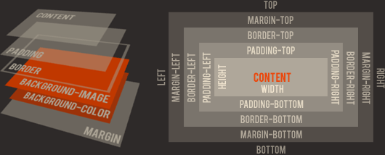
CSS
Box Model

Slide 74
HTML & CSS
?
Notes:
CSS Exercise coming next

Slide 75
CSS
http://bit.do/mikePFNP
Let’s Spruce Up Our Hello World Site!
Add it to your index.html’s <head>
<link rel=“stylesheet” href=“site.css”>
<style>
h1 {color:red;}
p {color:blue;}
</style>
Change the font color (color: red)
Make the text underlined (text-decoration: underline)
Add an image and make it’s size right (<img src="./ga-logo.png" /> height: 100px; width: 100px;)
Do a random thing (font-weight:bolder; background-color: orange;)

Slide 76
Programming 102

Slide 77
Programming 102
Basic Data Types
String “Hello” “a” “This is a string!”
Number 1 1.5 0.3333333
Boolean True False
NULL NULL
Notes:
Standard types:
Character (character, char)
Integer (integer, int, short, long, byte) with a variety of precisions;
Floating-point number (float, double, real, double precision);
Fixed-point number (fixed) with a variety of precisions and a programmer-selected scale.
Boolean, logical values true and false.
Reference (also called a pointer or handle), a small value referring to another object's address in memory, possibly a much larger one.
Null – lacking a value
First example of things directly related to bits / bytes / memory storage, hint of how the code we right will truly have an effect on memory consumption

Slide 78
Programming 102
Variables
Named Local Representation of Something and it’s State
Do Actions On
Pass into and out of Functions
Have a “Scope”
name = “Mike” name contains Mike
situps = 97 + 1 + 1 + 1 + 1 situps contains 101

Slide 79
Programming 102
Conditionals
If this, then do that
Can be chained together
Can be nested inside of each other
If key fits in lock
Then unlock door
height = 60
if(height > 65) {
print “Enjoy the ride!” } else {
print “Must be at least 65 inches to ride this ride!”
}

Slide 80
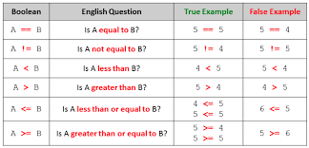
Programming 102
Comparison Operators

Slide 81
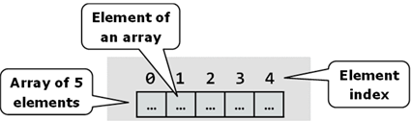
Programming 102
Arrays
List of things favFruits = [“Nectarine”, “Cherry”, “Blueberry”]
favFruits[0] would give you “Nectarine”
favFruits[3] is an error

Slide 82
Programming 102
Loops
Repeating things in order
Can be nested (be careful here!)
for(int i = 0; i < 5; i++) { Prints out 0, 1, 2, 3, 4,
print i + “, ”;
}

Slide 83
Programming 102
Functions
Unit of work
Individually responsible for as little action as possible
Optionally Accept Data as Arguments, return Data as a Result
These are essentially just variables
Functional vs Procedural
Notes:
Functional
Focus on what information is desired and what transformations are required.
Act purely on what information is given to the function
Extremely useful in certain scenarios
Procedural
Focus on how to perform tasks (algorithms) and how to track changes in state.
Act based on the overall state of the application or information passed
More common

Slide 84
Programming 102
?
Notes:
Matching Exercise coming next

Slide 85
Programming 102
Using the handout, connect the examples with the corresponding programming concept!

Slide 86
Databases

Slide 87
Databases
Organized collection of data
Source of all user entered or automatically collected data
Relational vs non
Table vs Web
Common Types: mySQL, Oracle, MongoDB
Notes:
SQL (Structured Query Language)

Slide 88
Databases
CRUD
Create
Read
Update
Destroy
Also can be SCRUD (Searching)

Slide 89
Databases
Queries
Ask the DB for information
In Memory Vs In Database
Multiple Ways to Find Every Result Set
Never Trust User Input!
“Johnny Drop Tables”
Notes:
https://xkcd.com/327/

Slide 90
Databases
Columns
Declared to be a single type from set of options
Options differ between database types
Other things settable
Uniqueness
Allow Nulls
Auto-Incrementing
Generate Value
Notes:
CHAR, VARCHAR, INT, BOOL, DECIMAL, FLOAT, DATETIME, BLOB

Slide 91
Databases
Create
INSERT INTO Toys (Name, Fun, Price, Owned)
VALUES (‘Ipad’, 8, 350, FALSE), (‘Yo-Yo’, 6, 4.99, TRUE)
ID | Name | Fun | Price | Owned
1 | Pet Rock | 1 | 0 | FALSE
2 | Xbox | 7 | 350 | FALSE
3 | Ball | 5 | 5 | TRUE
4 | Green Army Men | 4 | 2.5 | TRUE
5 | Star Wars Lego | 10 | 79.99 | FALSE
6 | Ipad | 8 | 350 | FALSE
7 | Yo-Yo | 6 | 4.99 | TRUE
ID | Name | Fun | Price | Owned
1 | Pet Rock | 1 | 0 | FALSE
2 | Xbox | 7 | 350 | FALSE
3 | Ball | 5 | 5 | TRUE
4 | Green Army Men | 4 | 2.5 | TRUE
5 | Star Wars Lego | 10 | 79.99 | FALSE

Slide 92
Databases
Read
SELECT * FROM Toys WHERE Price < 100 AND Fun > 7 AND Owned = 0
ID | Name | Fun | Price | Owned
1 | Pet Rock | 1 | 0 | FALSE
2 | Xbox | 7 | 350 | FALSE
3 | Ball | 5 | 5 | TRUE
4 | Green Army Men | 4 | 2.5 | TRUE
5 | Star Wars Lego | 10 | 79.99 | FALSE
ID | Name | Fun | Price | Owned
5 | Star Wars Lego | 10 | 79.99 | FALSE

Slide 93
Databases
Update
UPDATE Toys SET Price = 3.50 WHERE ID = 4
ID | Name | Fun | Price | Owned
1 | Pet Rock | 1 | 0 | FALSE
2 | Xbox | 7 | 350 | FALSE
3 | Ball | 5 | 5 | TRUE
4 | Green Army Men | 4 | 2.5 | TRUE
5 | Star Wars Lego | 10 | 79.99 | FALSE
ID | Name | Fun | Price | Owned
1 | Pet Rock | 1 | 0 | FALSE
2 | Xbox | 7 | 350 | FALSE
3 | Ball | 5 | 5 | TRUE
4 | Green Army Men | 4 | 3.5 | TRUE
5 | Star Wars Lego | 10 | 79.99 | FALSE

Slide 94
Databases
Destroy
DELETE FROM Toys WHERE ID = 2
ID | Name | Fun | Price | Owned
1 | Pet Rock | 1 | 0 | FALSE
2 | Xbox | 7 | 350 | FALSE
3 | Ball | 5 | 5 | TRUE
4 | Green Army Men | 4 | 2.5 | TRUE
5 | Star Wars Lego | 10 | 79.99 | FALSE
ID | Name | Fun | Price | Owned
1 | Pet Rock | 1 | 0 | FALSE
3 | Ball | 5 | 5 | TRUE
4 | Green Army Men | 4 | 2.5 | TRUE
5 | Star Wars Lego | 10 | 79.99 | FALSE

Slide 95
Databases
Keys
Primary
Foreign
ID | Name
1 | Matel
2 | Lego
3 | Nike
4 | Microsoft
5 | Earth
ID | Name | Fun | Price | Owned | Manufacturer ID
1 | Pet Rock | 1 | 0 | FALSE | 5
2 | Xbox | 7 | 350 | FALSE | 4
3 | Ball | 5 | 5 | TRUE | 3
4 | Green Army Men | 4 | 3.5 | TRUE | 1
5 | Star Wars Lego | 10 | 79.99 | FALSE | 2

Slide 96
Databases
Indexes
Data will be stored in order according to chosen indexes
Querying based on indexes is fastest possible
ID | Name
1 | Matel
2 | Lego
3 | Nike
4 | Microsoft
5 | Earth
ID | Name | Fun | Price | Owned | Manufacturer ID
1 | Pet Rock | 1 | 0 | FALSE | 5
2 | Xbox | 7 | 350 | FALSE | 4
3 | Ball | 5 | 5 | TRUE | 3
4 | Green Army Men | 4 | 3.5 | TRUE | 1
5 | Star Wars Lego | 10 | 79.99 | FALSE | 2

Slide 97
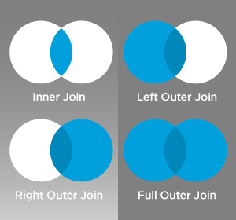
Databases
Joins

Slide 98
Databases
Transactions
Group together set of Queries
Only Commits changes if all succeed
Enables easier error handling

Slide 99
Databases
?
Notes:
CSS Exercise coming next

Slide 100
Databases
Using the handout, connect the database operation with the resulting datatable!

Slide 101
Javascript

Slide 102
JavaScript
How the content behaves
Heavily used in Single Page Applications
When this button is clicked, do this
var name = prompt(“What is your name?”);
document.getElementsByTagName('h1')[0].innerHTML = name

Slide 103
JavaScript
Lots of Libraries and Frameworks that will make it easier
Javascript
document.getElementsByTagName('h1')[0].innerHTML = name
jQuery
$(“h1”).html(name);

Slide 104
Node.js

Slide 105
Node.js
Package.json
{
"name": “my-first-node-app",
"main": “app.js",
"dependencies": {
"body-parser": "^1.15.0",
"cors": "^2.7.1",
"express": "~4.0.0“
}
“dev-dependencies”: {
“karma”: “~2.00”
}
}
npm install

Slide 106
Node.js
var express = require('express');
var app = express();
var router = app.Router(); // get an instance of the express Router
router.get('/', function(req, res) {
res.json({ message: ‘Hooray! Welcome to our server!' });
});
router.post('/', function(req, res) {
res.json({ message: ‘Hooray! Welcome to our server!' });
});
var port = process.env.PORT || 8080;
app.listen(port);
console.log('Magic happens on port ' + port);

Slide 107
Node.js
Creating an API
router.get('/user', function(request, result) {
var user = _userRepository.FindUser(request.UserId);
result.json({ userId: user.Id , name: user.Name, city: user.City });
});
router.post('/user', function(request, result) {
var user = _userRepository.CreateUser(request.Name, request.City);
result.json({ userId: user.Id, name: user.Name, city: user.City });
});
router.get('/userCity', function(request, result) {
var user = _userRepository.FindUser(request.UserId);
result.json({ userId: user.Id, city: user.City });
});

Slide 108
Node.js
Running The App
node app.js
http://bit.do/mikePFNP
Must have correct case!
Be sure you’re looking at the SingleDay Branch!
Installing Postman Will Help Test Your Routes

Slide 109
JavaScript & Node.JS
?
Notes:
CSS Exercise coming next

Slide 110
Resources

Slide 111
Resources
Help! I’m Stuck!
Google!
Stack Overflow
css-tricks
mdn
caniuse.com
API documentation

Slide 112
Resources
Inspiration
Dribble
Product Hunt
Hacker News

Slide 113
Resources
Further Learning
Online Vs Bootcamp Vs Immersive
Treehouse
CodeAcademy
Scotch.io
GA

Slide 114
Recap

Slide 115
Recap
Programming 101
Servers Vs Browsers
Process of Writing Code
HTML
CSS
Build a Website!
Programming 102
Databases
JS
Node.js / APIs
Build a Web App!
Notes:
Programming 101
What is programming?
Why are there so many programming languages and how do they fit together?
Back-end vs Front-end Development
Back-end and Front-End Frameworks
Servers Vs Browsers
What are Requests and Responses?
The anatomy of a web server
Process of Writing Code
Web Development Process
Programming 102
Basic Programming Concepts
APIs
Creating your own

Slide 116
Programming 101
Programs are ordered sets of Instructions to accomplish a task
Open toy chest
Pick up toys
Put toys in toy chest
Open hamper
Pick up clothes
Put clothes in hamper
And so on…
Pick up toys
Put toys in toy chest
Pick up clothes
Put clothes in hamper
Make bed

Slide 117
Servers Vs Browsers
Static Files
Server Code
Database
JavaScript
HTML
CSS
Web Server
User’s Machine

Slide 118
Process of Writing Code
Notes:
Start out being given a wireframe or design of what you need to create
Will have a spec documenting the required features and functionality of the thing to create

Slide 119
HTML
<html>
<head>
<title>This is my very first website!</title>
</head>
<body>
<h1 id=“page-heading”>Hello World!</h1>
<img class=“red-border” src=“folder/names/sleepingBaby.jpg”/>
<a href=“https://google.com” >Click Me To Go To Google</a>
<body>
</html>

Slide 120
CSS
Box Model

Slide 121
Databases
CRUD
Create
Read
Update
Destroy
Also can be SCRUD (Searching)

Slide 122
JavaScript
How the content behaves
Heavily used in Single Page Applications
When this button is clicked, do this
var name = prompt(“What is your name?”);
document.getElementsByTagName('h1')[0].innerHTML = name

Slide 123
Recap
?

Slide 124
Post-It Note Review
At least 1 thing for each of:
What’s the topic(s) that you understand the best?
What’s the topic(s) that was confusing or you wanted to know more about?
What’s the topic(s) that wasn’t discussed that you wanted to hear about?

Slide 125
Thanks For Coming!
Contact Info:
mike@zippyinnovations.com

